Slide 1
Liver Disease Prediction
Ismam Hussain Khan-1610991642

Slide 2
Attributes
1.Age
2.Gender
3.total BIlrubin
4.Direct Bilirubin
5.Alkaline Phosphotase
6.Alamine Aminotransferase
7.Aspartate Aminotransferase

Slide 3
8.Total_Protiens
9.Albumin
10.Albumin_and_Globulin_Ratio

Slide 4
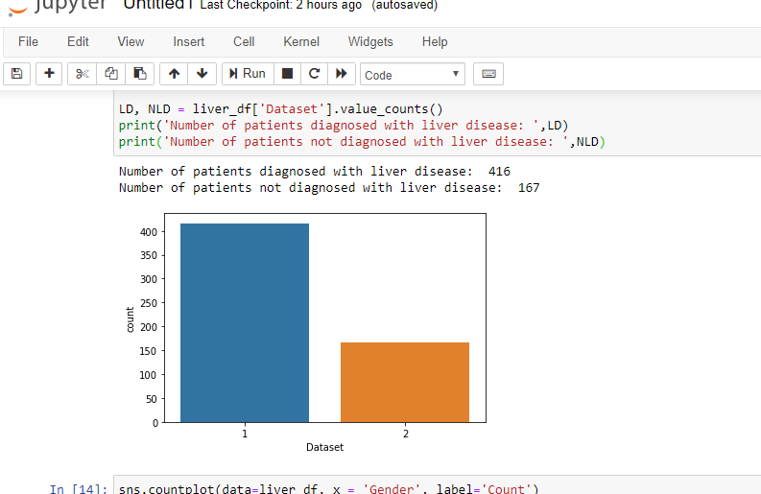
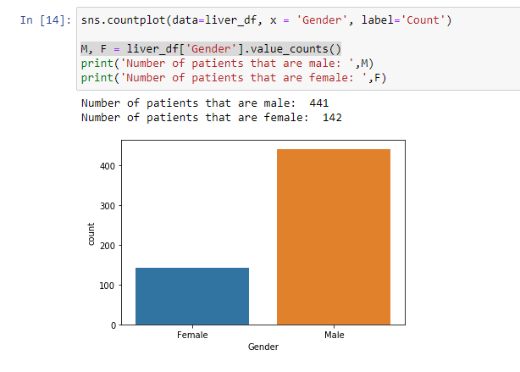
Visualization

Slide 5
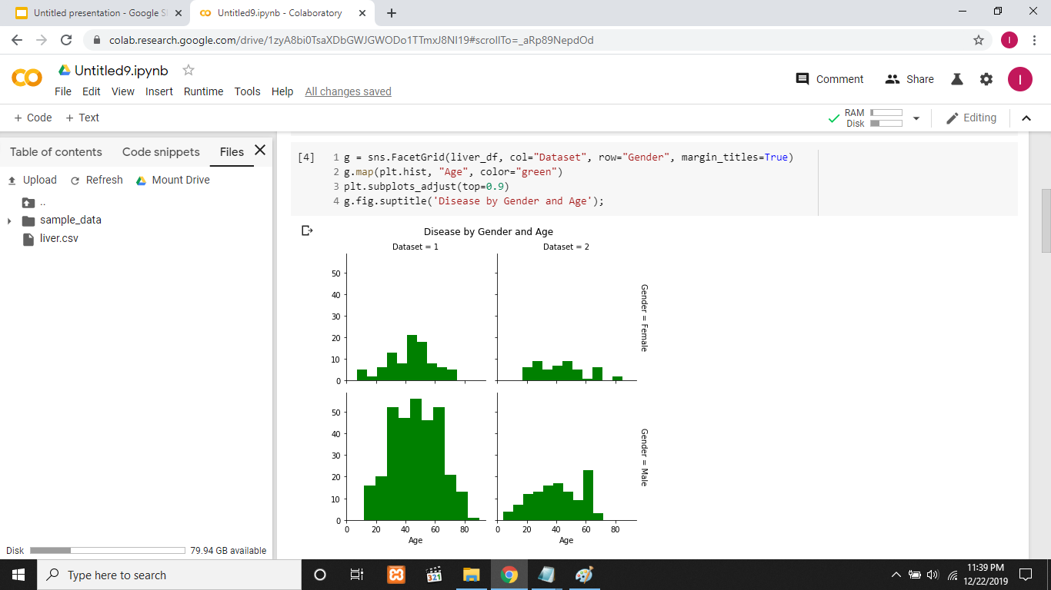

Slide 6
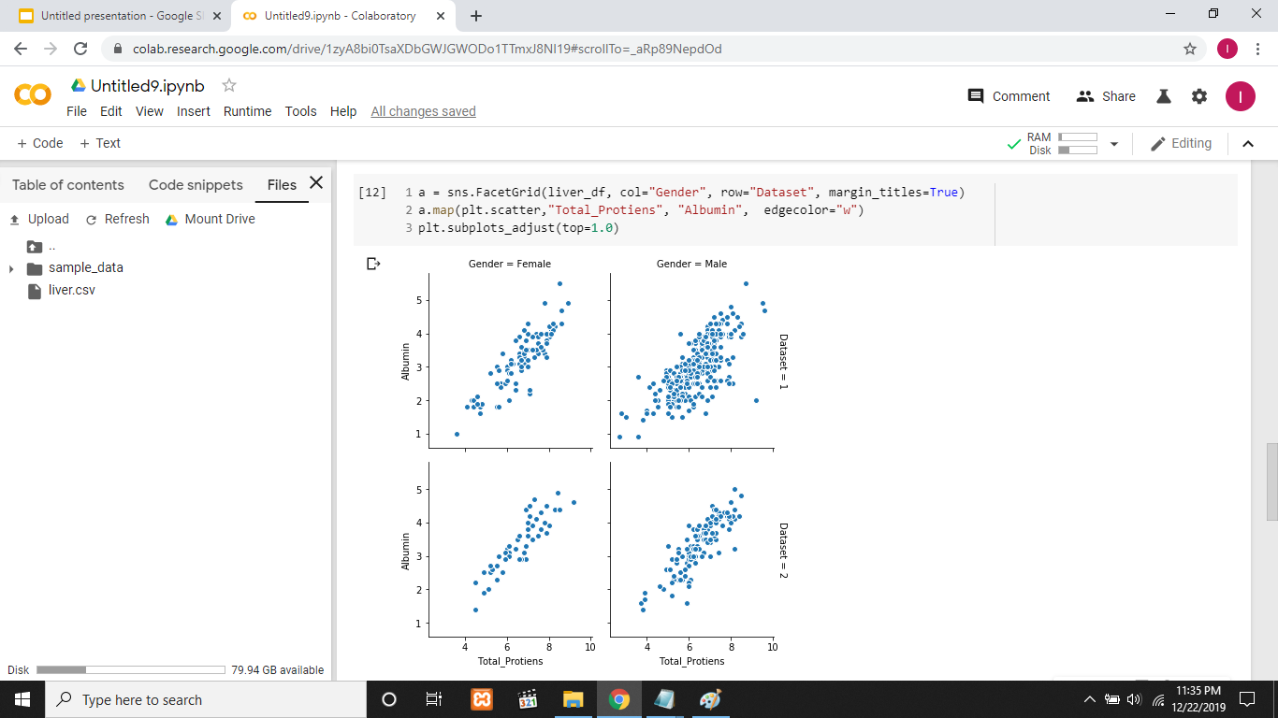

Slide 7
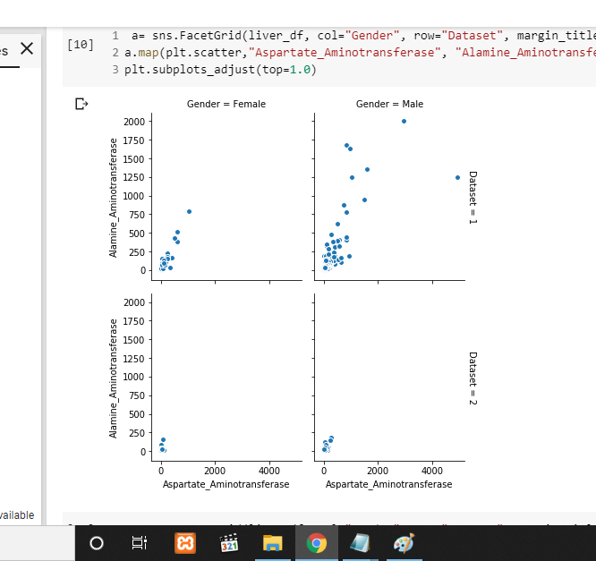
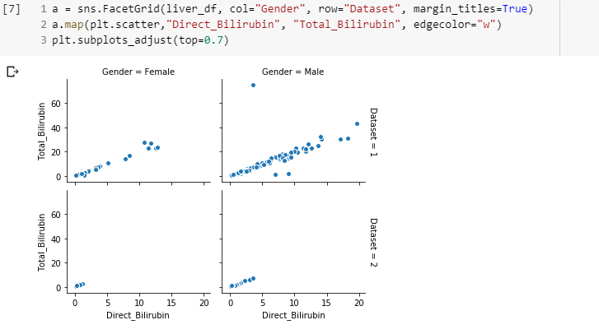

Slide 8
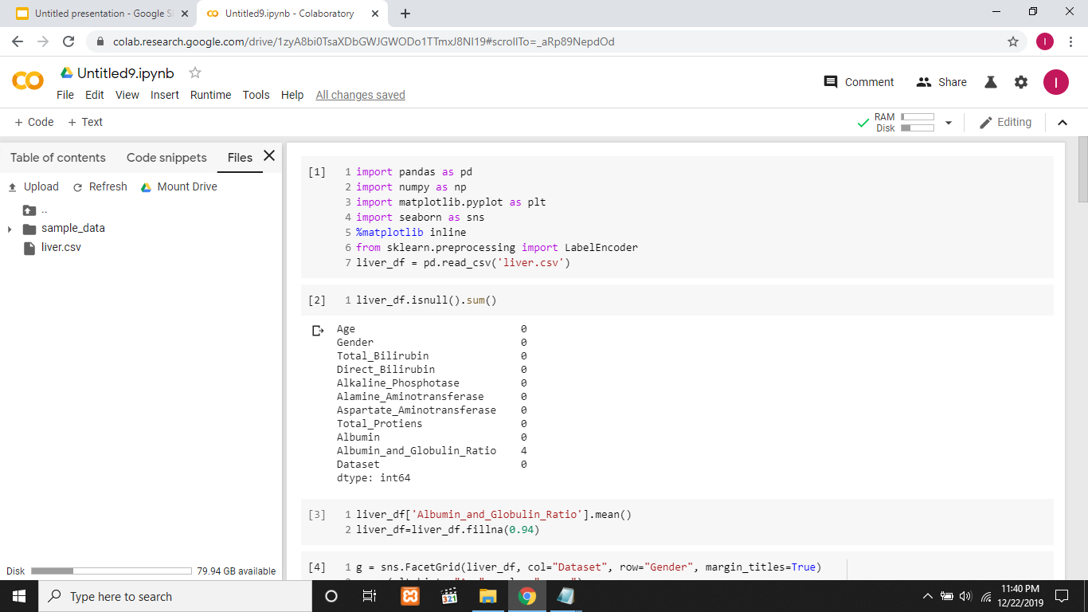

Slide 9
Analysis and Preprocess
1)After visualization i discovered that some attributes have linear correlation and i have the option to drop one of them.However dropping them doesn’t increase accuracy so i didn’t.
2)NULL VALUE : filled the null values of column with the mean value of that column
3)Normalization: I applied max-min normalization technique
4)Changed string values of ‘Gender’ column to numbers

Slide 10
Algorithm
I applied 5 algorithms on the dataset:
1.KNN(10 N)
2.Logistic Regression
3)SVM
4)Random Forest(Estimators=50)
5)ANN(3 hidden layers,Optimizer=’adam’)

Slide 11
Result
Classifier | Tranng Accuracy(%) | Testing Accuracy(%)
SVM | 71.08 | 72
Random Forest | 100 | 76.57
ANN | 71.07 | 100
KNN | 75 | 74.29
Logistic Regression | 73.53 | 72.57

Slide 12
Thank you!!

